Slide 1
THE PRESENT SIMPLE
TENSE

Slide 2

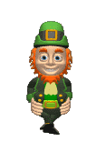
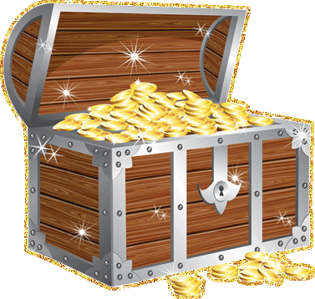
My sister ……… like to read books.
DO
DOES
DON’T
DOESN’T
WRONG
Great!

Slide 3
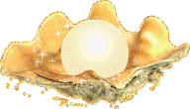
……… your friend live in London?
DO
DOES
DON’T
DOESN’T
WRONG
Great!

Slide 4

……… Ann and Pam like to sing?
DO
DOES
DON’T
DOESN’T
WRONG
Great!

Slide 5

My little brother ……… go to school yet.
DO
DOES
DON’T
DOESN’T
WRONG
Great!

Slide 6

The boys……… want to skate.
DO
DOES
DON’T
DOESN’T
WRONG
Great!

Slide 7

When ……… you usually get up?
DO
DOES
DON’T
DOESN’T
WRONG
Great!

Slide 8
What game……… your sister like to play?
DO
DOES
DON’T
DOESN’T
WRONG
Great!

Slide 9

My father……… go to the swimming pool every day.
DO
DOES
DON’T
DOESN’T
WRONG
Great!

Slide 10
Where……… your uncle live?
DO
DOES
DON’T
DOESN’T
WRONG
Great!

Slide 11
GOOD JOB!

